Slide 1
Simple GA Operators
Tian-Li Yu
tianliyu@cc.ee.ntu.edu.tw
Department of Electrical Engineering
National Taiwan University
Acknowledgment
David E. Goldberg’s slides for his GA course.
Ying-Ping Chen’s slides for his EC course.

Slide 2
Agenda
Initialization
Selection
Proportionate
RW, SUS, SRS
Rank-based
Ranking, Truncation, Tournament, Mu-lambda
Multi-point crossover
Mutation clock
Termination condition
Implementation

Slide 3
Initialization
Without prior knowledge, initialization with unbiased random.
If you know some specific pdf, use it to generate the initial population.
Or a portion of good individuals and a portion of random guesses.

Slide 4
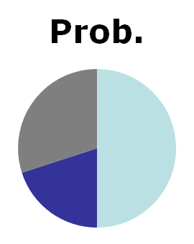
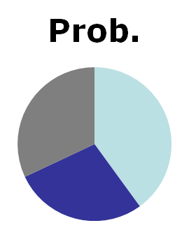
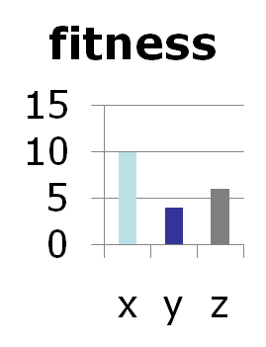
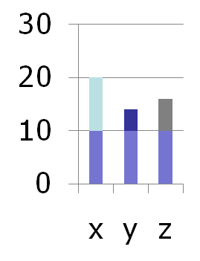
More about Selection
We’ve seen RW-selection, truncation selection.
Truncation → simple, easy to implement and analyze, but fitter guys do not get more copies.
RW-selection → noisy and can be biased.

Slide 5
Stochastic Remainder Selection (SRS)
Calculate the expected number of copies for each individual.
Each individual gets duplicated as many copies as the integer part of the expected value.
The fractional remainder is treated as the probability of further duplication.

Slide 6
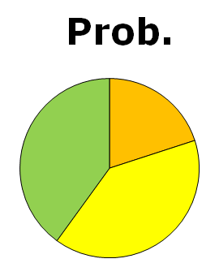
SRS (contd.)
1 copy
x1
x1
x2
x4
x1
x3
2 copies
x4
x3
Decided by
x4
?
x2

Slide 7
Stochastic Universal Selection (SUS)
Sort individuals in the order of their fitness values.
Create a roulette wheel.
Select the first individual at random , where F is the total fitness and n is the population size.
Then select individuals at , where
.

Slide 8
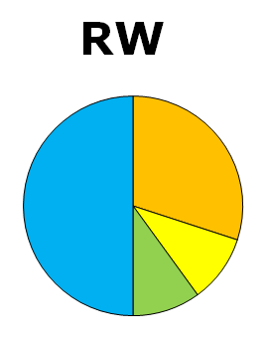
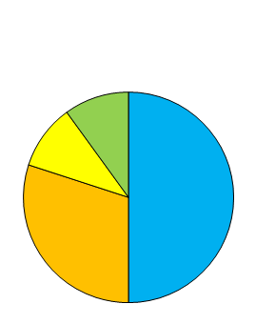
SUS (contd.)
x1
Random 0~40/4
x4
36
39
35
0
x2
32
x4
31
x3
x1
x4
x2
20
19

Slide 9
Fitness Scaling
SUS and SRS are much less noisy than RW-selection.
How about bias?
What if we have a fitness function ranged from 100000 to 100010?
What about negative fitness values?
Linear scaling
f’=af+b

Slide 10
Linear Scaling
f_{max}
f_{min}
f'_{min}
f'_{max}
Usually, f'_{min}=0. But no strong reason to do so.
Good to use when fitness values have physical meanings.
Otherwise, use rank-based selection.

Slide 11
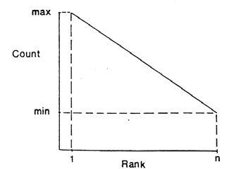
Ranking Selection
Median guy gets one copy, above-median guys get more, below fewer.
Perform a sort from best to worst.
Assign higher numbers of offspring to individuals with higher rank.
Get the same effective
performance with
tournament selection.

Slide 12
Truncation Selection
1/s-th of population gets s copies
Selection pressure: s
Ratio of the best individual's selection probability to the average selection probability of all individuals.
Can think of this as nonlinear scaling.
xxxxx
yyyyy
-----
-----
-----
-----
xxxxx
xxxxx
xxxxx
yyyyy
yyyyy
yyyyy

Slide 13
Mu-lambda Selection
Selection after generating offspring
Two variations.
(μ, λ) : no elitism.
(μ + λ) : elitism embedded.
parent + offspring
μ
offspring
parent
λ
next gen.
parent
λ
next gen.
μ
μ
μ
μ
(μ, λ)
s= λ/ μ
(μ+λ)
s= (λ+ μ)/ μ

Slide 14
Tournament Selection
Rank-based
With or without replacement
Tournament size: s (same symbol as selection pressure) or s_{tournament}
Randomly pick s_{tournament} guys into a tournament. Select the best guy and put it into the mating pool.
Repeat until the mating pool is filled.

Slide 15
With or Without Replacement
w/o : less noisy, slightly difficult to program.
You’ll need to repeat the tournament exactly s times to fill the mating pool.
The best guy gets exactly s_{tournament} copies in the w/o version.
Here “exactly” means when s_{tournament} divides n
Also, when s is an integer (p_{winner} = 1).

Slide 16
Controlling Tournament Selection
Probabilistic control: for 1<s<2
s_{tournament} = 2 (any larger s_{tournament} yields noisy results).
Choose winner with p_{winner} between 0.5 and 1;
Choose loser with (1-p_{winner}).
Gives selection pressure s=2p_{winner} between 1 and 2.
Tournament size control
What is the effect of a tournament with more than s_{tournament} participants?
Best gets s_{tournament} copies on average

Slide 17
Efficiency
If t_{f} » t_{ga} then why bother? Expensive evaluation.
GA calculations go up with string length and population size.
Some things can be done easily:
Use more efficient GA operators when expected effect is the same.

Slide 18
Selection Comparison
Selection | Running Time | Not Noisy
Roulette wheel | O(n²) or O(nlogn)*
SRS | O(n²) or O(nlogn)*
SUS | O(nlogn) or O(n)**
Truncation | O(nlogn) or O(n)***
Mu-lambda | O(nlogn) or O(n)***
Ranking | O(nlogn)
Tournament w/ replacement | O(n)
Tournament w/o replacement | O(n)
* When binary search is adopted.
** When SUS without sorting first.
*** When O(n) finding-median algorithms is adopted.

Slide 19
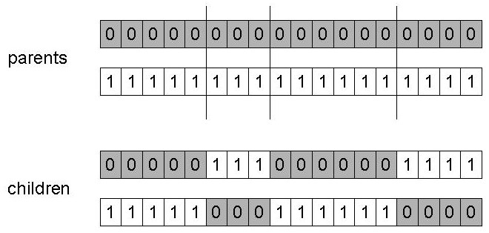
Multi-point & Uniform Crossover
Two-point crossover
M -point crossover
Circular if M even
Linear if M odd

Slide 20
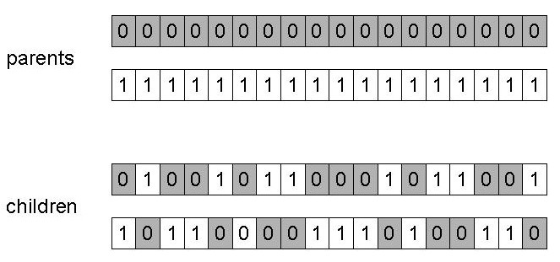
Uniform Crossover
Every gene comes from dad with probability p, from mom with probability (1-p).

Slide 21
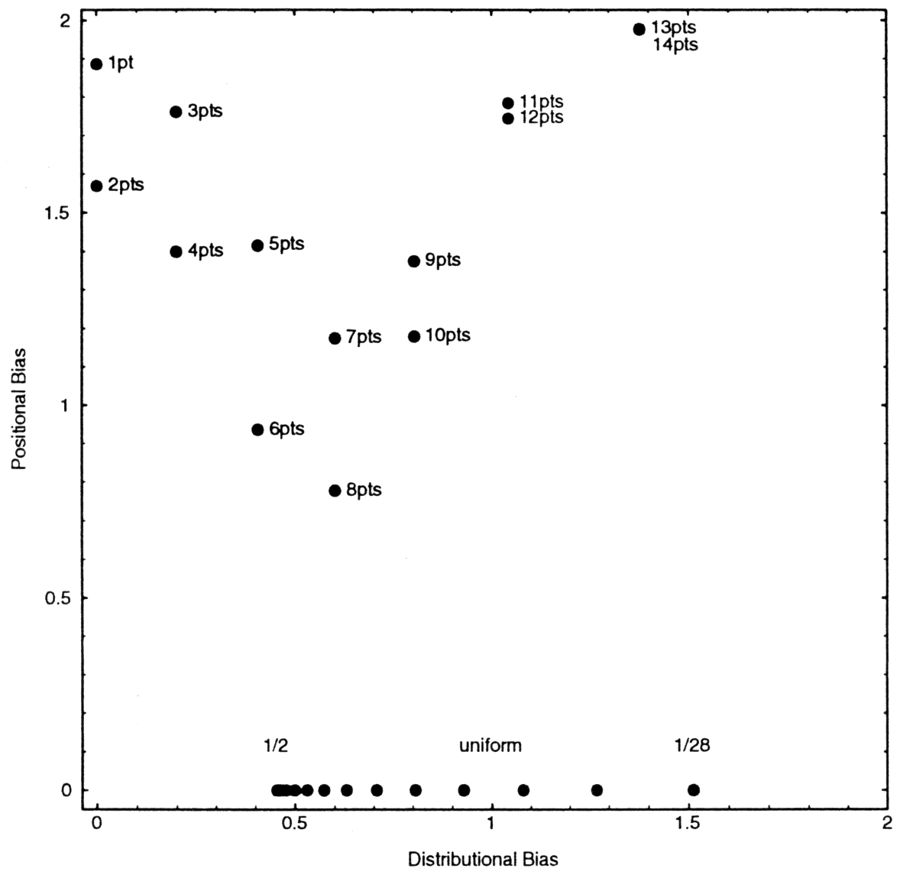
Positional/Distributional Bias
Positional
The probability that two genes transfer together depends on their positions.
Distributional
The probability distribution of the proportion of genes coming from one parent.
14 bits
Eshelman, Caruana, & Schaffer (1989). Biases in the crossover landscape.

Slide 22
Mutation Clock
Waiting time is distributed geometrically.
Generate uniform random number, and calculate time to next mutation.
Go from nl random numbers per generation to p_{m}nl.
Easy to do and worthwhile.

Slide 23
Mutation Clock: Theory
Success on first mutation: p_{m}
Success on second mutation: (1 – p_{m}) p_{m}
Success on third mutation: (1 – p_{m})² p_{m}
Success on t^{th} mutation: (1 – p_{m})^{t-1} p_{m}
Cumulative distribution: Pr(i≤t)=1 - (1 – p_{m})^{t}

Slide 24
Mutation Clock: Calculation
Cumulative distribution is geometric.
Randomly generate 0<Pr<1.
Calculate t, and then mutate the t-th gene.

Slide 25
Replacement
Elitism.
Why throwing the best guy when we see it?
Mu-lambda replacement scheme.
Side effect: increasing selection pressure.
A proportion of best parents, and a proportion of newly generated offspring.
Keeping a window of best individuals seen so far.

Slide 26
Elitism or Not?
Pros: faster convergence, never losing the best guy during the run.
Cons: premature convergence.
According to experience, niching+elitism is a good combination.
We’ll talk about niching later.

Slide 27
Termination Conditions
Time constraint.
Stop when the solution is satisfactory.
Stop when the population loses diversity.
Large population, fewer generations?
Small population, longer run duration?
Time continuation problem.

Slide 28
Implementation
Random number generator
Class Chromosome
Class GA
GA operator implementation

Slide 29
Random Number Generator
Pseudo
Consider a 1000-bit problem, n=10000, G=100.
Using uniform crossover → at least 10⁹ random number procedure calls.
For a 10000-bit problem, about 10¹² calls.
Mersenne Twister
A very fast random number generator Of period 2¹⁹⁹³⁷-1 (~10⁶⁰⁰⁰)
http://www.math.sci.hiroshima-u.ac.jp/~m-mat/MT/emt.html
The one comes with Matlab is fine, but the ones come with most PLs are NOT OK in general.

Slide 30
mt19937ar.cpp
void init_by_array (unsigned long init_key[], int key_length);
A way to provide 623-dimensional equidistribution.
double genrand_real1 (void); //[0,1]
double genrand_real2 (void); //[0,1)
double genrand_real3 (void); //(0,1)
double genrand_res53 (void); //[0,1)

Slide 31
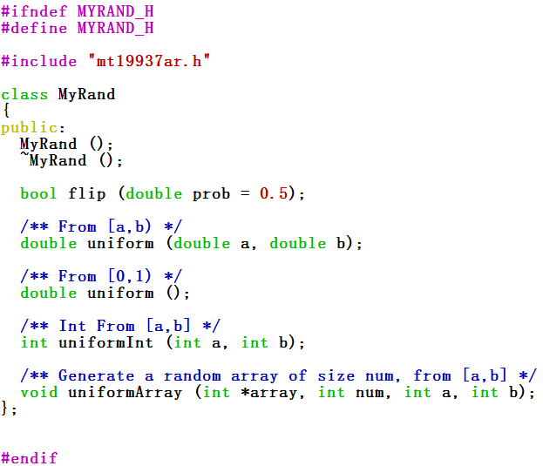
myrand.h

Slide 32
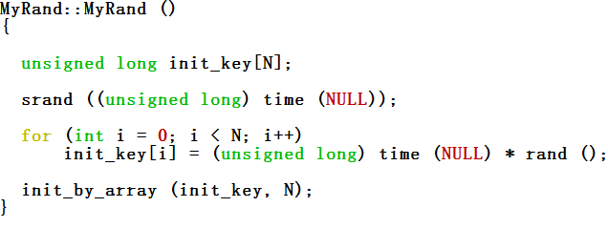
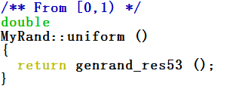
myrand.cpp
Initializer – 623 dimensional equidistribution.
[0,1)

Slide 33
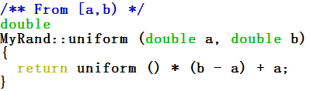

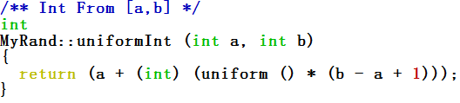
myrand.cpp (contd.)
[a,b)
Flip a coin
Integer from [a,b]

Slide 34
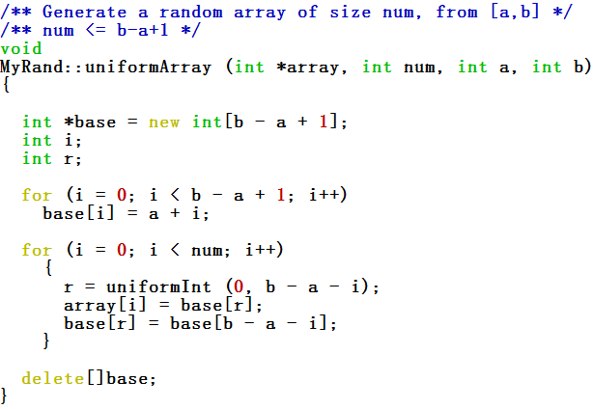
myrand.cpp (contd.)
O(n) algorithm to generate a random array

Slide 35
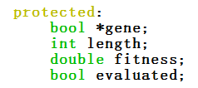
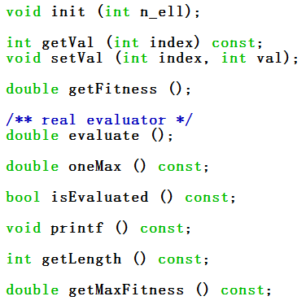
Class Chromosome
Member variables
Member functions

Slide 36
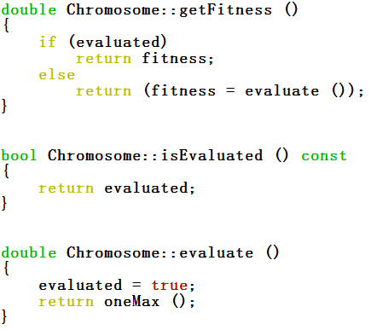
Do not Re-evaluate
Store the fitness that has been calculated.
For testing example

Slide 37
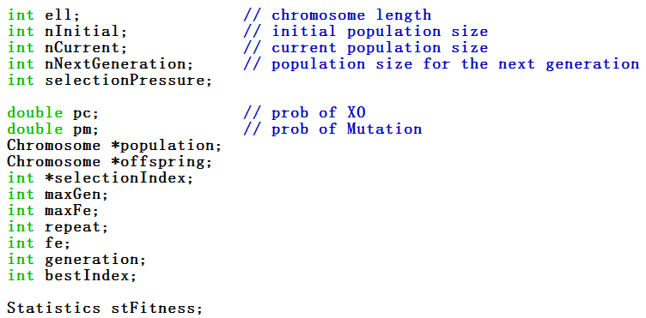
Class GA
Member variables

Slide 38
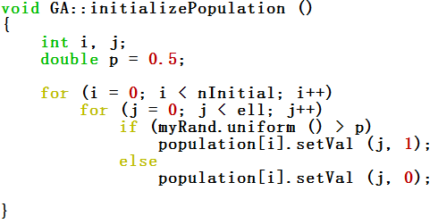
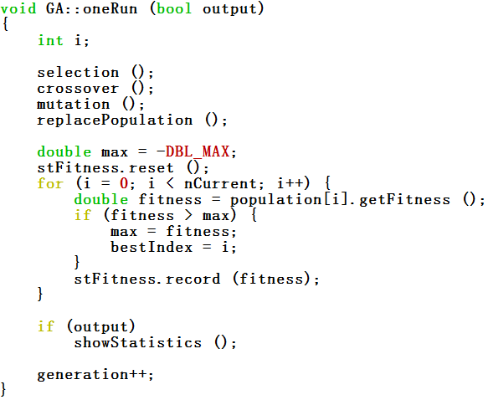
Initialization and oneRun
Initialization
oneRun

Slide 39
Selection
We use selectIndex instead of really duplicating chromosomes to save memory.
Roulette-wheel selection and tournament selection w/o replacement as examples.

Slide 40

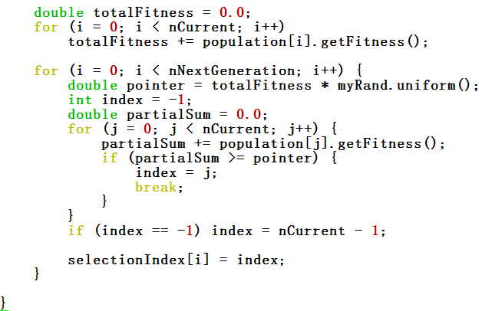
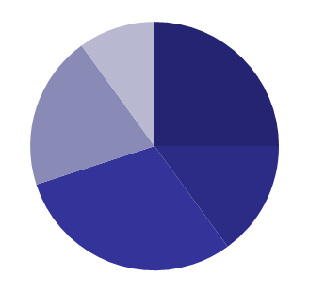
RW-Selection
totalFitness
partialSum
index
pointer

Slide 41
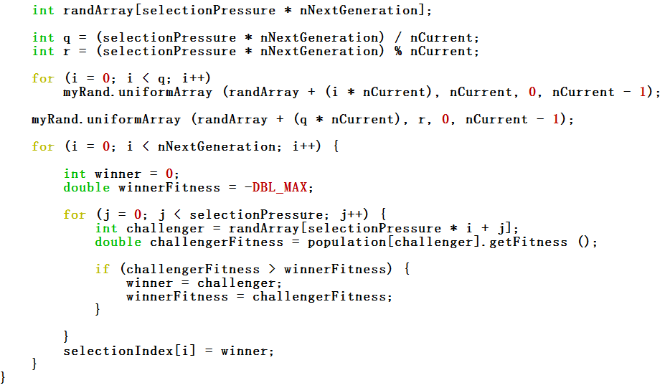
Tournament Selection w/o Replacement
Generate a random of size
nNextGeneration from [0, nCurrent-1]

Slide 42
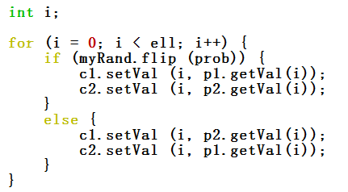
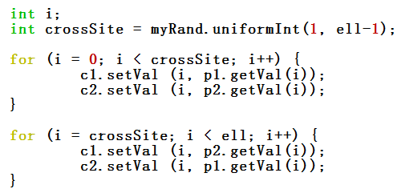
Crossover
Pair-wise
One-Point
Uniform

Slide 43
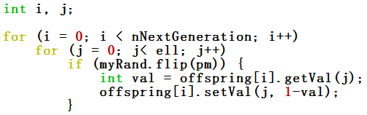
Mutation
Simple
For every bit, flip a coin to decide mutation or not
nl random calls per generation

Slide 44
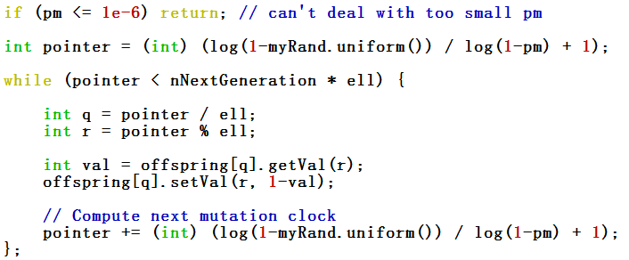
Mutation (contd.)
Mutation clock
Generate uniform random number, and calculate time to next mutation.
Go from nl random calls per generation to p_{m}nl.

Slide 45
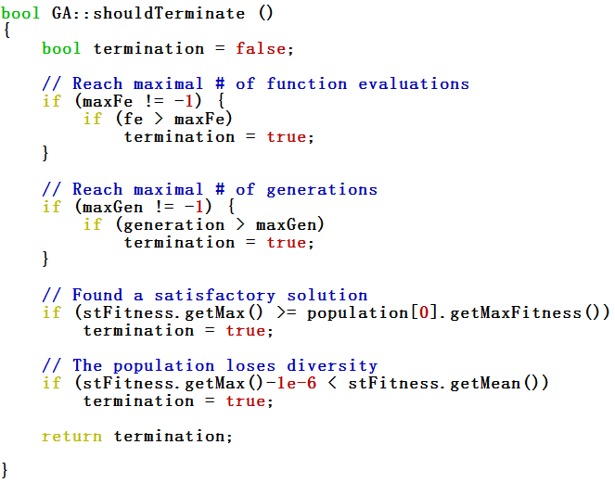
Termination Condition

Slide 46
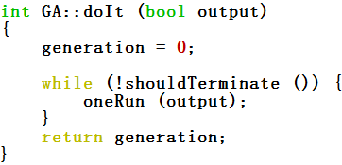
Finally, Do It!
You should play with the code, understand the code, and finally be able to write your own GA!!
sga-c++.tar.gz
No guarantee to be bug-free (no one really can).
Use it at your own risk.
But please let me know if you find anything wrong.

Slide 47
What’s Next?
Let’s explore GA theorems.
Schema theorem
Takeover time
Control map
Problem difficulty
BB hypothesis
Time-to-convergence
Population sizing
No-free-lunch (NFL) theorem

